Slide 1



COURSE NAME – EDA PROJECT CONTINUOUS ASSESSMENT-III
NAME :: Khurram Shahin
REG NO ::12112093 ROLLNO :: RK21UTA03 SUB CODE ::INT 353

Slide 2
INTRODUCTION
The Netflix dataset is a comprehensive collection of data meticulously tracking the digital entertainment consumption within the Netflix platform. This dataset encompasses a wealth of information, including details such as the titles of content, viewing trends, customer interactions, and more. It serves as an invaluable resource for deciphering viewing habits and preferences, enabling profound insights that can guide content recommendation, user experience enhancement, and content production strategies
Problem Description: The analysis is centered around a comprehensive dataset that encompasses income and demographic information, with the primary objective of gaining insights into the distribution of monthly income and its intricate relationships with various factors. This analysis has substantial implications in financial planning, market research, and any context where income data plays a pivotal role
Objectives of EDA:
Data Familiarization: Begin by familiarizing yourself with the dataset, understanding its composition, and gaining a clear overview of the variables it contains.

Slide 3
INITIAL TRENDS & INSIGHTS
In total it contains 12 columns, and the shape is (340, 12).
• The dataset contains information about movies and TV shows.
• Each row represents a single movie or TV show.
• The columns in the dataset are:
• show Id: A unique identifier for each movie or TV show.
• type: Indicates whether the item is a movie or a TV show.
• title: The title of the movie or TV show. • director: The director of the movie or TV show.
• cast: A list of the actors in the movie or TV show.
• country: The country where the movie or TV show was produced.
• date added: The date the movie or TV show was added to Netflix.
• release year: The year the movie or TV show was released.
• rating: The rating of the movie or TV show, such as TV-PG or PG-13
. • duration: The length of the movie or TV show in minute

Slide 4
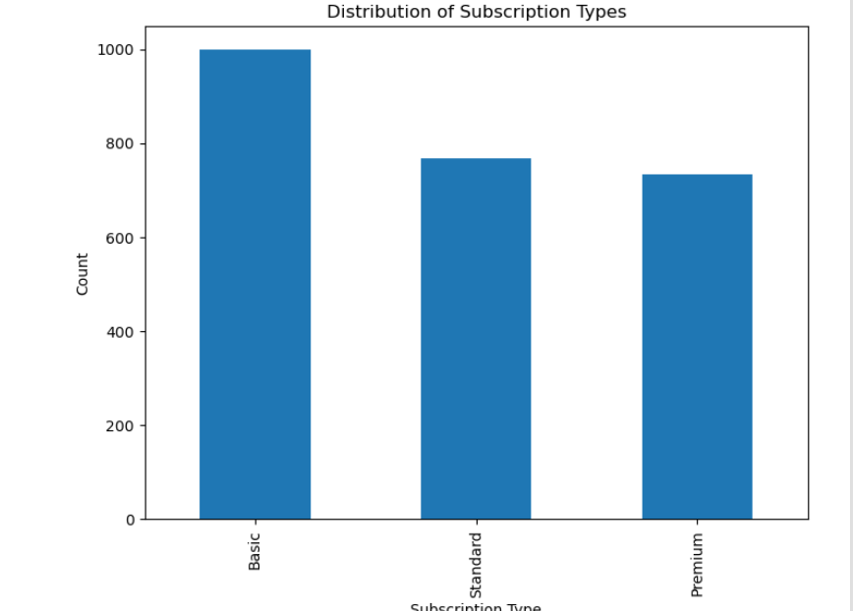
UNIVARIATE ANALYSIS
First I will Do Univarite Analysis on Categorical Data
Univariate analysis of Subscription Type
The majority of viewers, accounting for 40%, opted for the Basic
Type Subscription

Slide 5
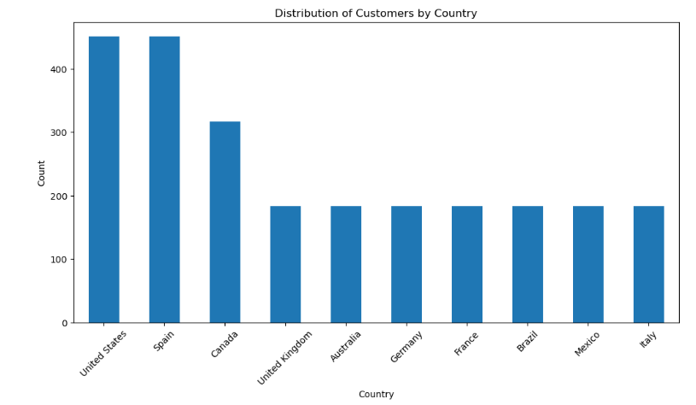
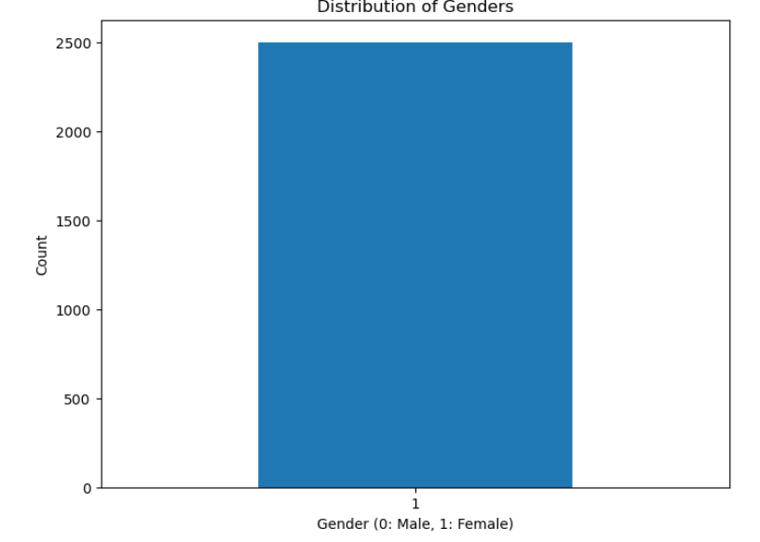
2. Frequency of Customers by Country
:Upon visualizing the data, the United States emerged with the highest customer frequency, while Italy exhibited the lowest
3. Univariate Analysis on Gender Column:
The analysis reveals a singular gender category, with only males represented in the dataset.

Slide 6
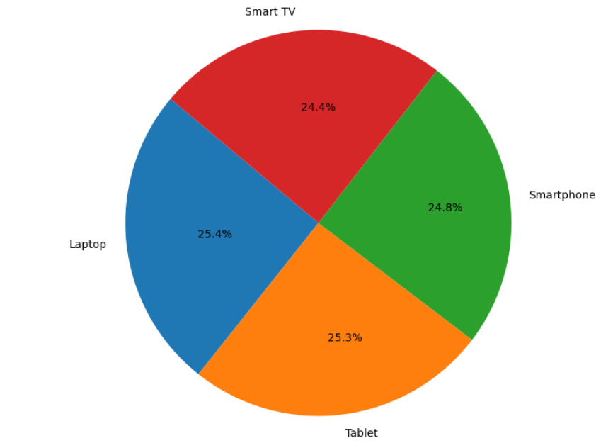
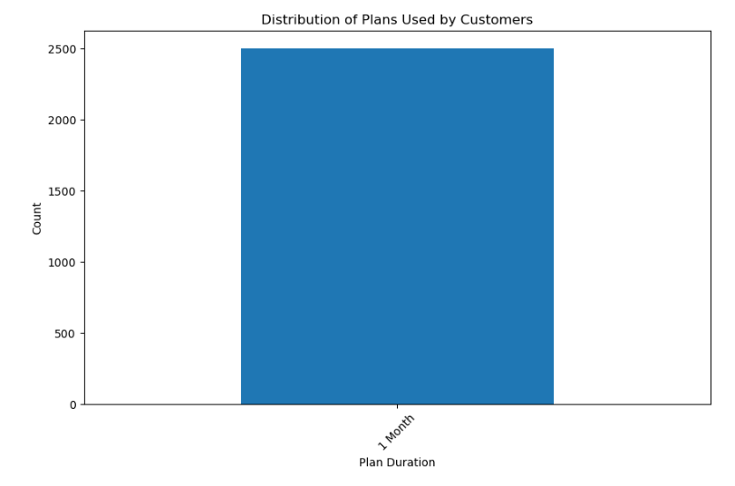
4. Frequency of Each Type of Device: Laptops dominated the platform, boasting the highest frequency, while Smart TVs lagged with the lowest frequency.
5. Analysis on Plan Duration Column:
Examination of the Plan Duration column indicates a uniformity, with a singular one-month plan duration.

Slide 7
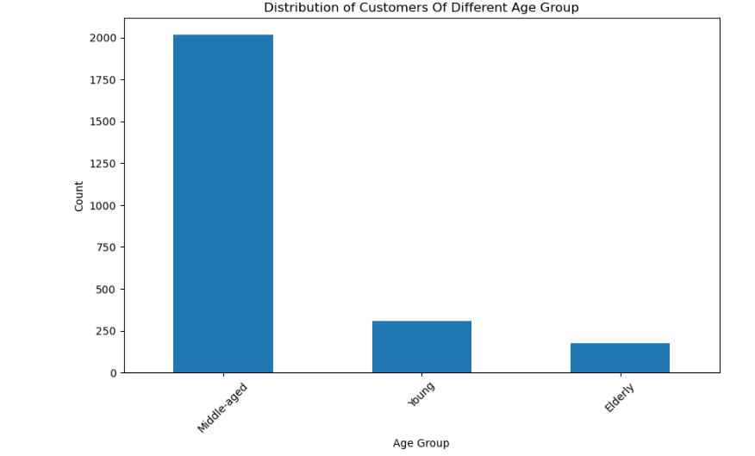
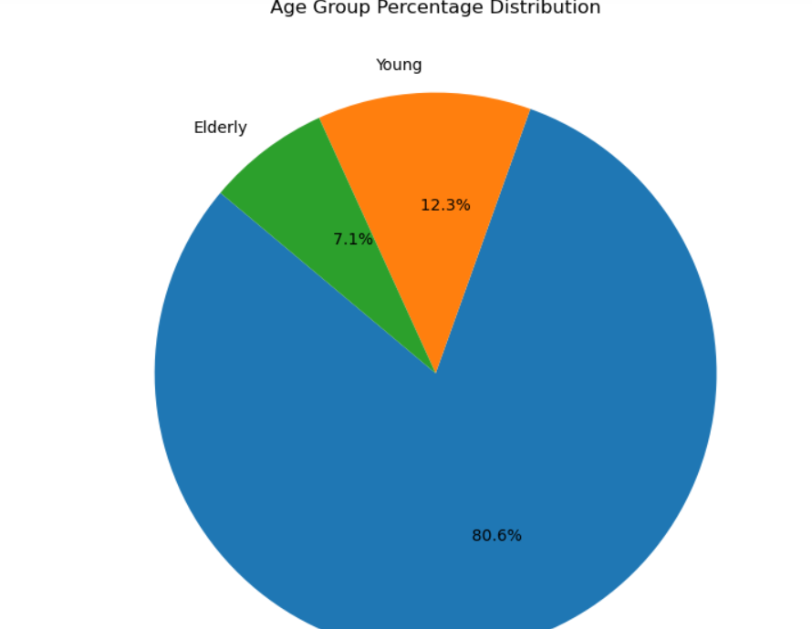
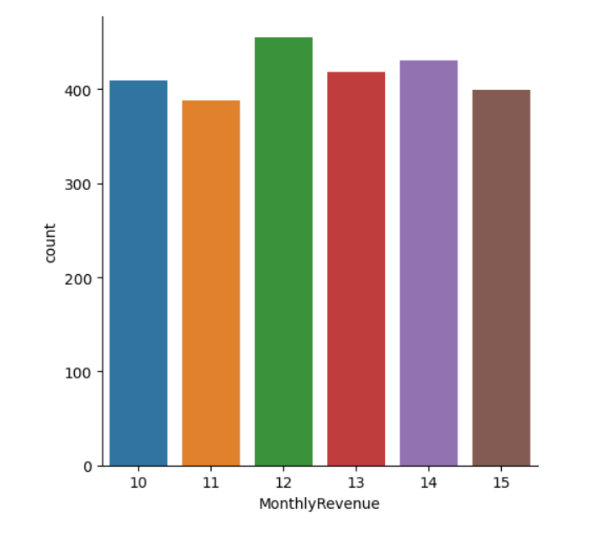
6. Analysis on Age Group
Among the age groups, the Middle Age category stands out, boasting the highest frequency of 2016 members.
7.Distribution of Monthly Revenue BY age group
Age Group Between 40 to 50 has highest monthly revenue
8. Average age of users subscribed to each subscription type in data?
Ans: The Average age of users subscribed to each subscription type in data is [Subscription Type Basic 32.0 Premium 38.0 Standard 36..0 ]
9. Analysis of monthly revenue

Slide 8
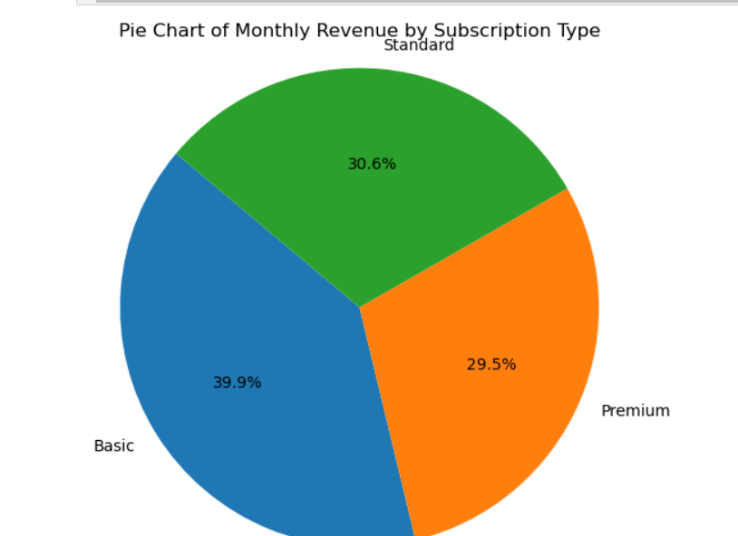
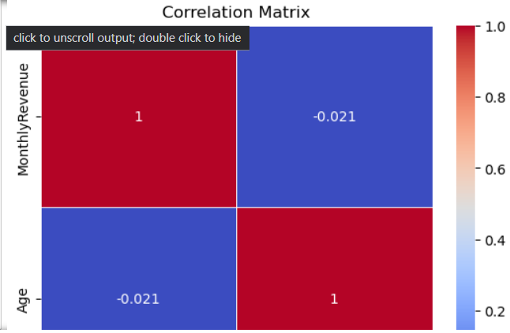
Bivariate Analysis
1. the relationship between 'Subscription Type' and 'Monthly Revenue.’
ans Basic Subscription Type Accounts for the Highest Revenue Generation of about 40 % of the total revenue
Correlation coefficient Between monthly Revenue and Age
There is a negative correlation of -0.02114326407144743 between Monthly revenue And Age

Slide 9
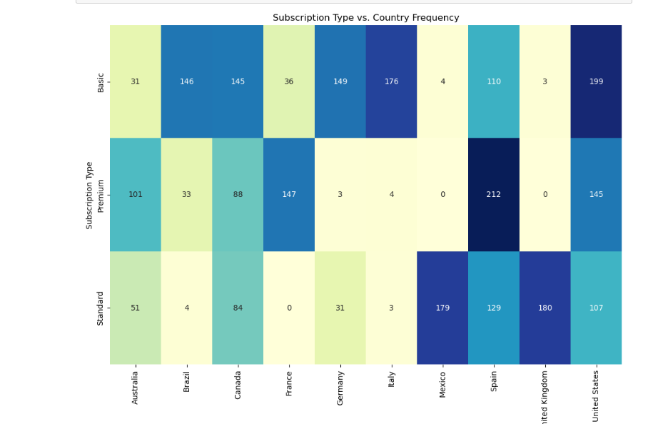
Relation Between subscription type and country
After Analysing we saw that France has lowest Standard Subscriber And UK has highest Standard Subscription
After Analysing we saw that UK has lowest Basic Subscriber And United States has highest Basic Subscription
After Analysing we saw that Mexico has lowest Premium Subscriber And France has highest Premium Subscription

Slide 10
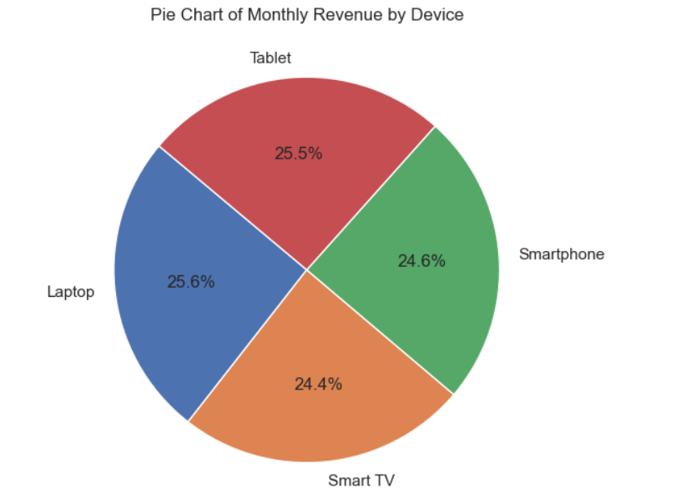
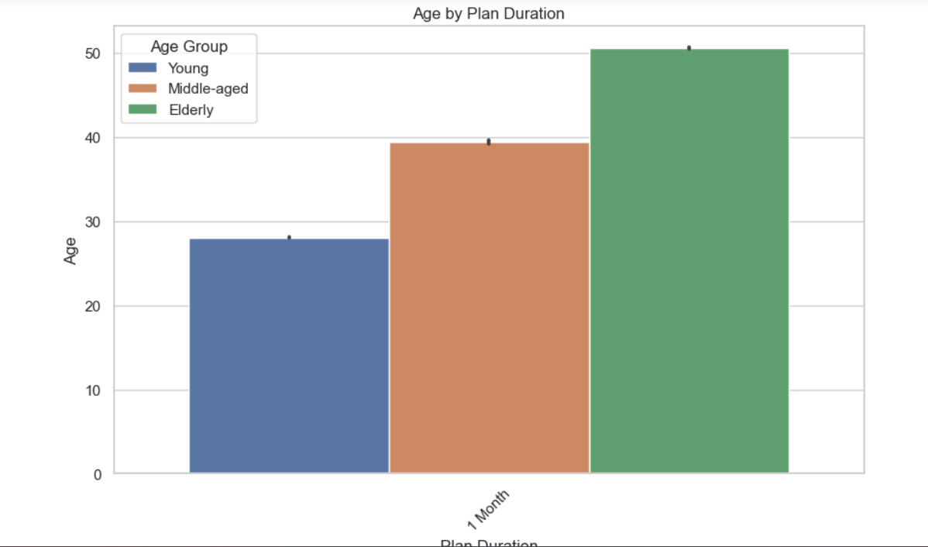
4.Relation Between Device and Monthly revenue?
Laptop generates the highest monthly revenue Which is approx. 27 % of the total monthly revenue
5.Relation between Age And Plan Duration?
Middle Age Group has highest Subscription Duration in all the Age Groups Which is About 80 % of the total duration

Slide 11
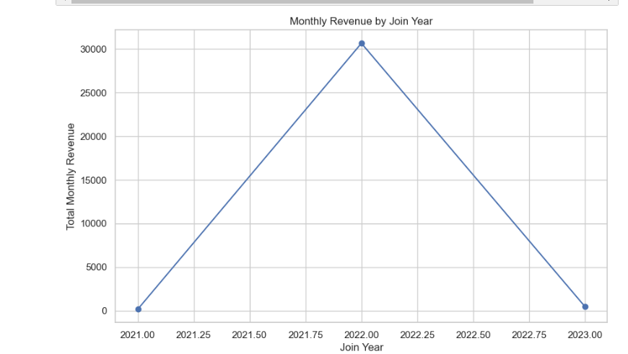
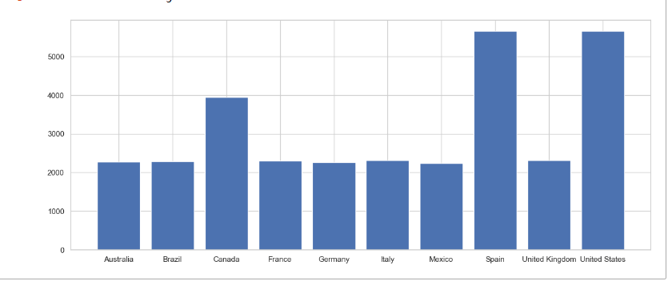
6. Monthly Revenue by join year ?
Line chart Shows That People Joining in Year(2022) Provides The Highest monthly Revenue
7 Relation Between Country and Monthly Revenue :
Country United States 5664

Slide 12
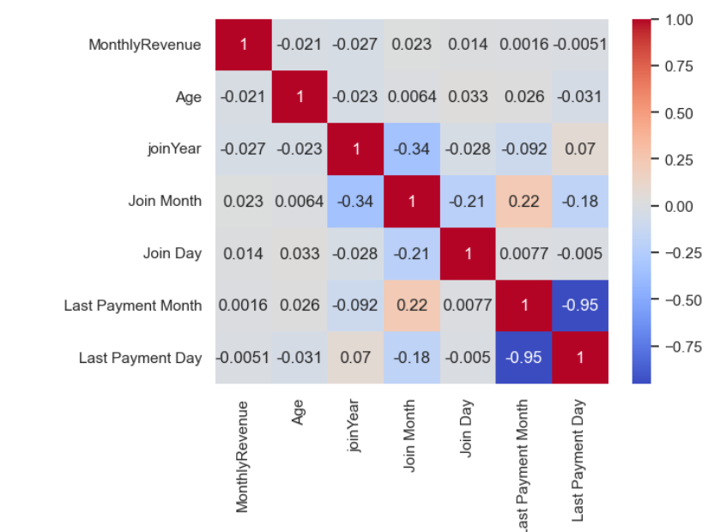
Multivariate Analysis
Q Correlation Matrix of All the Numerical Variables like 'Monthly Revenue', 'Age', 'join Year', 'Join Month’ etc
1 Monthly Revenue Decreases By increasing in Age Group
2Age And Join Date Has no correlation It means That there is no any relation between Join Date And Age
3.Join Day and last payment date has Alo no correlation Showing no relation in data
4.. Relation between Country And Monthly Revenue?
United States Give the Highest Monthly Revenue And Mexico gives The Lowest

Slide 13
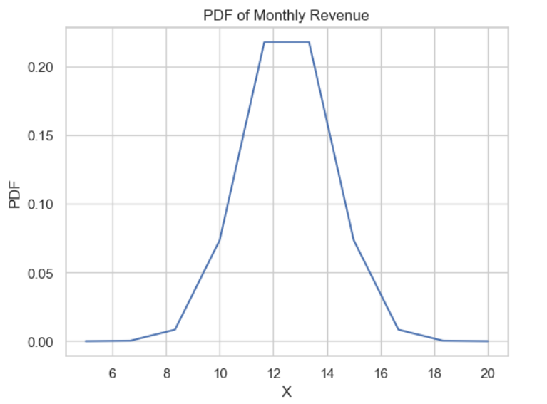
Distributions
Probably Distributions Function of Monthly Income?
As you can see The majority of income values cluster
around the mean (average) income, which is at the center of the curve.

Slide 14
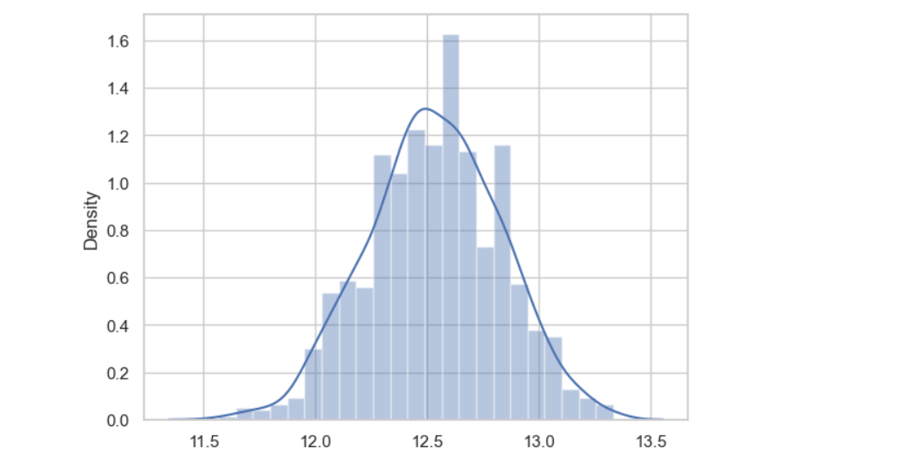
Let's take a random sample from this data, and see what mean we get.
Each time we take a sample, our mean value is different. There is variability in the sample mean itself. Does the sample mean itself follow a distribution? Let's assess this. We'll take many samples from the data, and plot a histogram of the same.

Slide 15
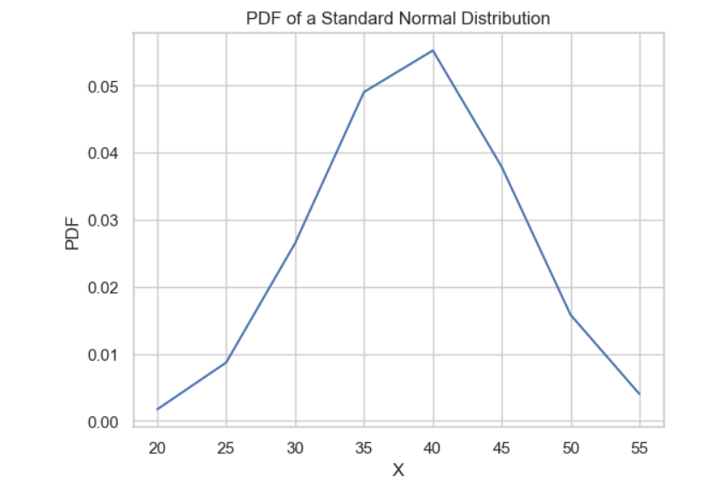
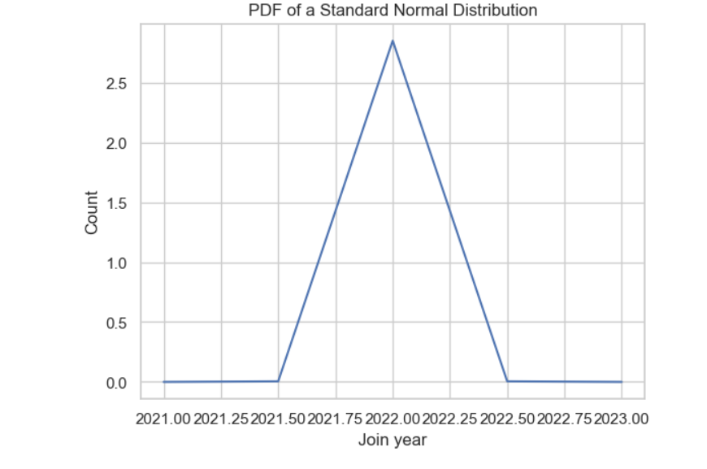
PDF OF Age Group?
As you can see the mean lies at 40 which indicates majority of customer are middle aged
PDF of joinYear ?
As we can see there is a slight increase in number of customer between the year 2021 and 2022

Slide 16
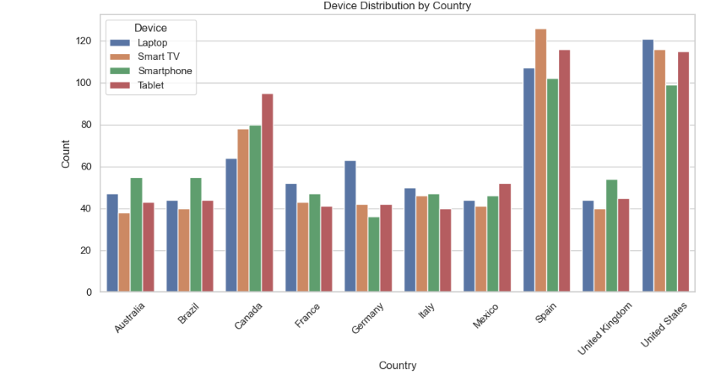
Relation Between Device and Country

Slide 17
Hypothesis Testing
Null Hypothesis (H0): The monthly revenue is the same for all subscription types. In other words, there is no significant difference in monthly revenue between subscription types.
Alternative Hypothesis (H1): The monthly revenue is not the same for all subscription types. There is a significant difference in monthly revenue between at least two subscription types. write a t test using python
After Analysing the Hypothesis Testing We Conclude That
Fail to reject the null hypothesis (H0).
There is no significant difference in monthly revenue between Basic and Premium.

Slide 18
Insights
Summary of Main Findings and Insights
Univariate Analysis
The majority of subscribers opted for the Basic Type Subscription (40%).
The United States had the highest customer frequency, while Italy had the lowest.
Only males were represented in the dataset.
Laptops had the highest frequency, while Smart TVs had the lowest.
All subscribers had a one-month plan duration.
The Middle Age category had the highest frequency (2016 members).
Bivariate Analysis

Slide 19
Insights
Basic Subscription Type accounted for the highest revenue generation (40%).
There is a negative correlation between monthly revenue and age (-0.02114326407144743).
France has the lowest Standard Subscriber and UK has the highest Standard Subscription.
UK has the lowest Basic Subscriber and United States has the highest Basic Subscription.
Mexico has the lowest Premium Subscriber and France has the highest Premium Subscriber.
Laptop generates the highest monthly revenue (27%).
Middle Age Group has the highest Subscription Duration (80%).
People joining in 2022 provide the highest monthly revenue.
Multivariate Analysis

Slide 20
Insights
Monthly revenue decreases with increasing age group.
Age and join date have no correlation.
Join day and last payment date have no correlation.
United States gives the highest monthly revenue and Mexico gives the lowest.
Distributions
The PDF of monthly income shows that the majority of income values cluster around the mean income.
The PDF of age group shows that the mean lies at 40, which indicates that most customers are middle-aged.
The PDF of join year shows a slight increase in the number of customers between the years 2021 and 2022.
The PDF of join month shows that there are more subscribers in the months of June to December.
Hypothesis Testing
The t-test showed that there is no significant difference in monthly revenue between Basic and Premium subscriptions.

Slide 21
Insights
Overall Insights
The majority of subscribers are middle-aged males who have opted for the Basic Type Subscription with a one-month plan duration.
Basic Subscription Type accounts for the highest revenue generation.
Laptops generate the highest monthly revenue.
Middle Age Group has the highest Subscription Duration.
People joining in 2022 provide the highest monthly revenue.
Monthly revenue decreases with increasing age group.
United States gives the highest monthly revenue and Mexico gives the lowest.

Slide 22
Recommendation
Target younger users. The analysis showed that younger users are more likely to subscribe to subscription services.
Subscription service providers should target younger users with their marketing campaigns and promotions.
Offer more flexible subscription plans.
The analysis showed that most users are subscribed to one-month plans.
Subscription service providers could offer more flexible subscription plans, such as three-month, six-month, and annual plans, to meet the needs of different users.
Improve customer retention.

Slide 23
Recommendation
The analysis showed that monthly revenue decreases with increasing age group.
Subscription service providers should focus on improving customer retention, especially among older users. This could be done by offering loyalty programs, discounts, and other incentives.
Expand into new markets. The analysis showed that the United States has the highest customer frequency for subscription services. Subscription service providers could expand into new markets, such as Mexico and Italy, which have lower customer frequencies.
Overall, the analysis suggests that subscription service providers have a number of opportunities to grow their businesses. By collecting more data, conducting causal tests, and using cross-validation techniques, subscription service providers can better understand their customers and develop more effective strategies to attract and retain them

Slide 24
Conclusion
The analysis showed that monthly revenue decreases with increasing age group.
Subscription service providers should focus on improving customer retention, especially among older users. This could be done by offering loyalty programs, discounts, and other incentives.
Expand into new markets. The analysis showed that the United States has the highest customer frequency for subscription services. Subscription service providers could expand into new markets, such as Mexico and Italy, which have lower customer frequencies.
Overall, the analysis suggests that subscription service providers have a number of opportunities to grow their businesses. By collecting more data, conducting causal tests, and using cross-validation techniques, subscription service providers can better understand their customers and develop more effective strategies to attract and retain them

Slide 25
Conclusion
The analysis showed that monthly revenue decreases with increasing age group.
Subscription service providers should focus on improving customer retention, especially among older users. This could be done by offering loyalty programs, discounts, and other incentives.
Expand into new markets. The analysis showed that the United States has the highest customer frequency for subscription services. Subscription service providers could expand into new markets, such as Mexico and Italy, which have lower customer frequencies.
Overall, the analysis suggests that subscription service providers have a number of opportunities to grow their businesses. By collecting more data, conducting causal tests, and using cross-validation techniques, subscription service providers can better understand their customers and develop more effective strategies to attract and retain them

